Slide 1



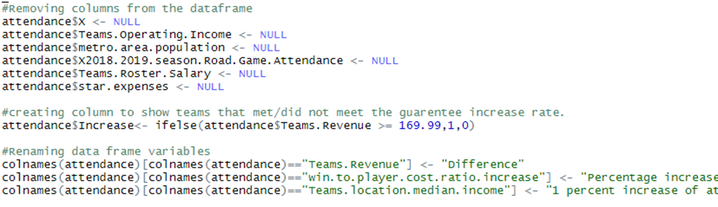
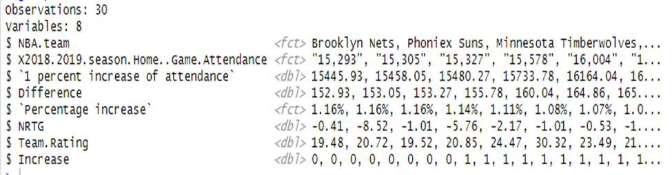
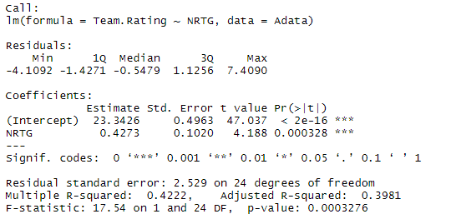
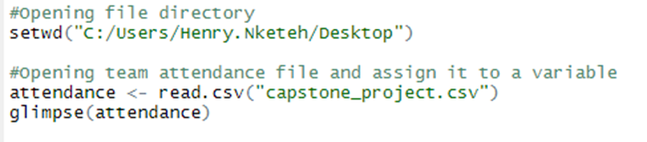
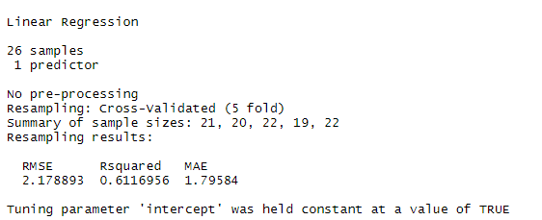
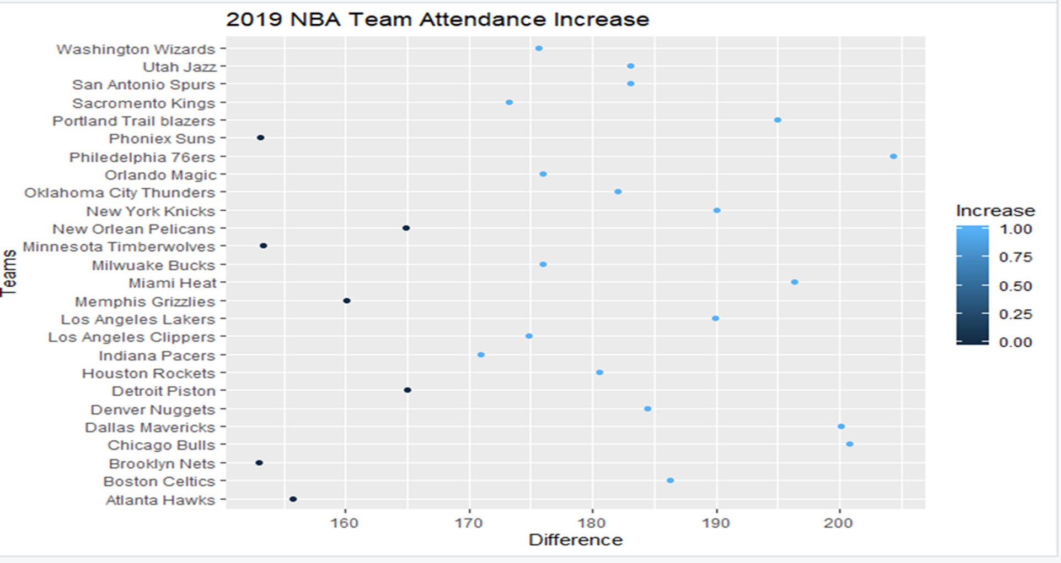
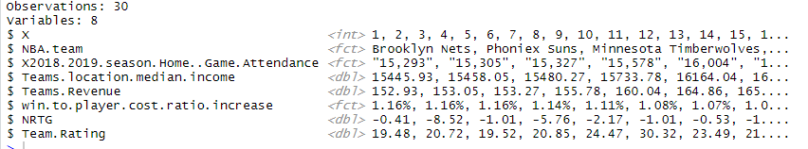
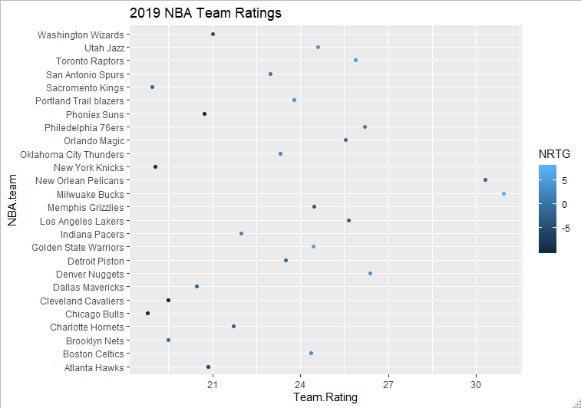
REPLACE THIS BOX WITH YOUR ORGANIZATION’S
HIGH RESOLUTION LOGO
The Impact of Star Power and Team Quality on NBA Attendance
Henry Nketeh, Clark Atlanta University
Torina Lewis, Ph.D, Clark Atlanta University
HBCU- UP Data science summer internship – Summer 2019
Abstract
Machine Learning
With the increase of digital information, professional teams are using data science and analytics to increase player and team performance. Techniques and tools for this purpose have been rightfully labeled as sports analytics by team and media representatives. In fact, the National Basketball Association (NBA) routinely draw on the services of a professional data analyst to support their operations. In this research, data science techniques are used to help NBA teams to increase their revenue through increased ticket sales. As a direct indicator of ticket sales, spectator attendance is an essential variable of the study. The purpose of this research project is to determine variables that influence spectator attendance at NBA games resulting in an increase in attendance for franchises by an average of 1%. Franchises that can successfully create an increase in team home game attendance will generate more revenue to build more competitive teams.
During our machine learning we split our data into two different sets to get our validation results. We then split it into a training dataset which is 80% of our data and a testing dataset which is 20%. When testing the training data set the model shows that NRTG is the best variable to predict the team rating. NRTG is the most significant variable because it has a multiple R^2 value of .6116956, a p value of .0003276, a RMSE value of 2.178893, and a significance code of three stars.
Figure 3. Data Wrangling code
Figure 7. Code to get P value
Research Question
What variables affect spectator attendance at NBA home games?
Figure 4. Data frame wrangled
Data Frame
Statistical Analysis
The data set used was accessed online through public data. It consisted of variables such as NBA Teams road and home attendance data, the team’s location median household income, the team’s revenue, the teams operating income, win to player cost ratio, metro area population, player expenses, and the team’s roster salary, net rating (NRTG), and team rating which was composed of the highest player efficiency rating PER of that team.
Figure 5. shows that the majority of the league's teams have the capacity to increase attendance by an average of 1%, which is 179 fans. On the graph the x-axis is comprised of the difference of the 1% increase and original attendance while the y-axis is the NBA teams. Then the dots represent the teams increase percentage. The number 179 originated from multiplying the attendance by 1% and then subtracting the attendance from the 1% and then taking the average of all of the differences the number 179 was created. Figure 6. shows a correlation between the net rating and team rating of all the teams.
Figure 8. Model summary includes P value and significance code
Figure 9. Code for testing control dataset
Figure 1. Code to glimpse of the data set
Figure 10. Summary of Linear regression model Statistics includes RMSE, and R^2
Results
The results from our cross validation observations displayed the root mean squared (RMSE) and R^2 variable and how both are significant to our predictions. The RMSE shows how close the independent variable is to the line of best fit, it can range from 0 to any number. The smaller the number the better the model. The NRTG model has a RMSE value of 2.178893 and due to how close our number is to 0 our model is good enough. Then another determinant of selecting the best model is the multiple R squared value. The R squared value determines how “close” the points are to the regression line. The values range from 0 to 1, with values closer to 1 indicating that the data points are “closer” and more tightly correlated to the regression line. The closer the R squared is to 1 the better the model is, our R squared value is .6116956 therefore again validating the significance of the variable towards the dependent variable.
2. Linear regression model is Y (attendance) = 23.3426 + 0.4273 (team rating)
Figure 5. 2019 NBA team attendance increase scatter plot
Figure 2. Glimpse of the data set
Methods
Data Wrangling
The dataset was provided with nearly all the complete information needed. However, a couple of data wrangling techniques are to be used to achieve a clean data set. As you can see there are 30 observations (rows) and 8 variables in our dataset. All of the variables are very self-explanatory but there are a couple variables that need to be renamed, deleted, and added another variable to display 1 for the teams that have the capacity to increase attendance by an average of 1%, which is 179 fans and 0 for otherwise.
Future Work
In our future works we will create a program to merge data from various data sets to find more significant independent variables that can attribute to a better model that will influence the results for my dependent variable more significantly allowing a more efficient model to be constructed.
Figure 6. 2019 NBA Team Rating
References
Acknowledgements
I would like to acknowledge my Springboard mentor, Dr.Andrea Constantinof, and my faculty mentor, Dr. Torina Lewis for their expressed support, and the Dr. Mintz the principal investigator of the HBCU-UP Implementation Program for the opportunity to learn Data Science. This research opportunity was sponsored by the National Science Foundation, award numbers 1700408 and 1818682.

